Slide 1
House Prices: Advanced Regression Techniques
Team members:
Yaohua Chang
Wenyu Fan
Tamer Ibrahim
DSE I2100 Applied Machine Learning and Data Mining

Slide 2
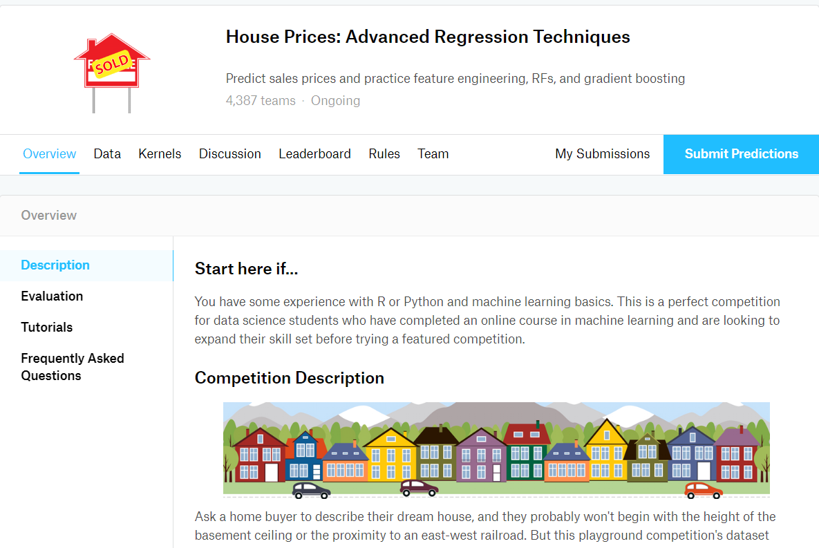
Kaggle Challenge

Slide 3
Importance of the Problem
A model like this would be very valuable for a real state agent who could make use of the information provided in a daily basis.
Evaluate the price of your house to get a loan from bank
If you are looking for house, an app can use the prediction of house prices to help customers where to look.

Slide 4
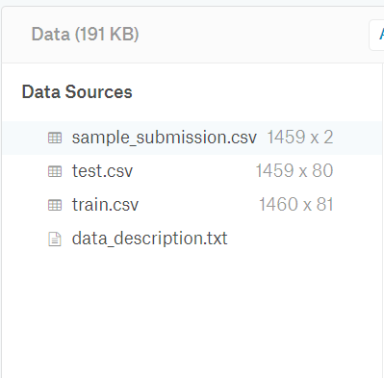
Train and Test data

Slide 5
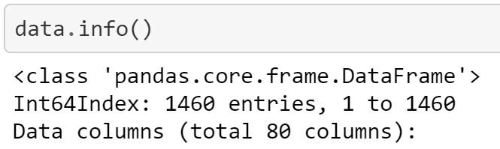
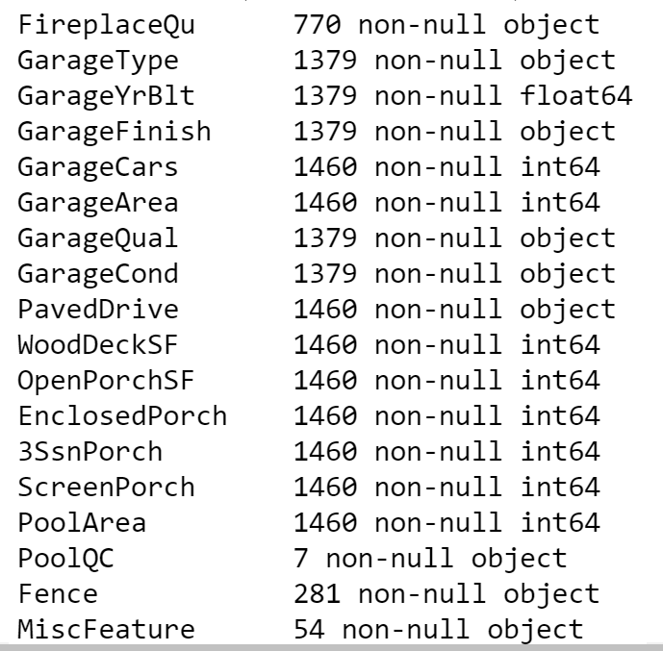
Missing Data

Slide 6
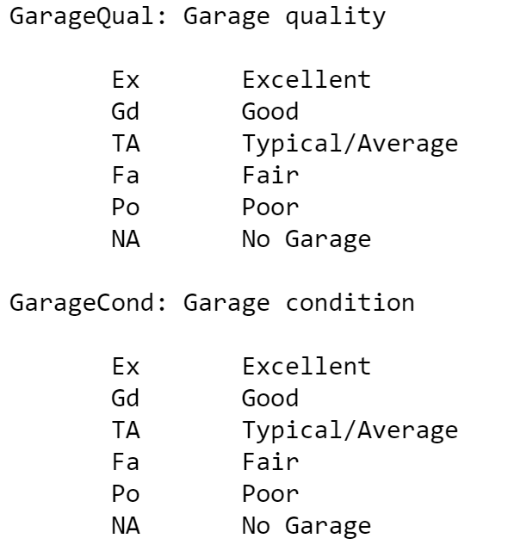
Missing Data

Slide 7
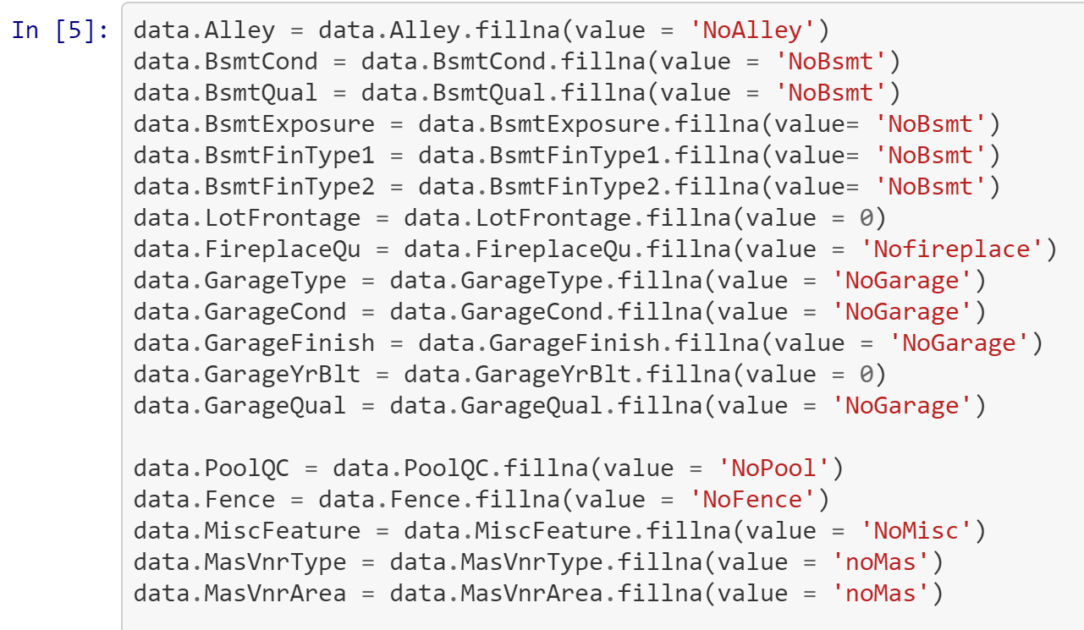
Data Cleaning

Slide 8
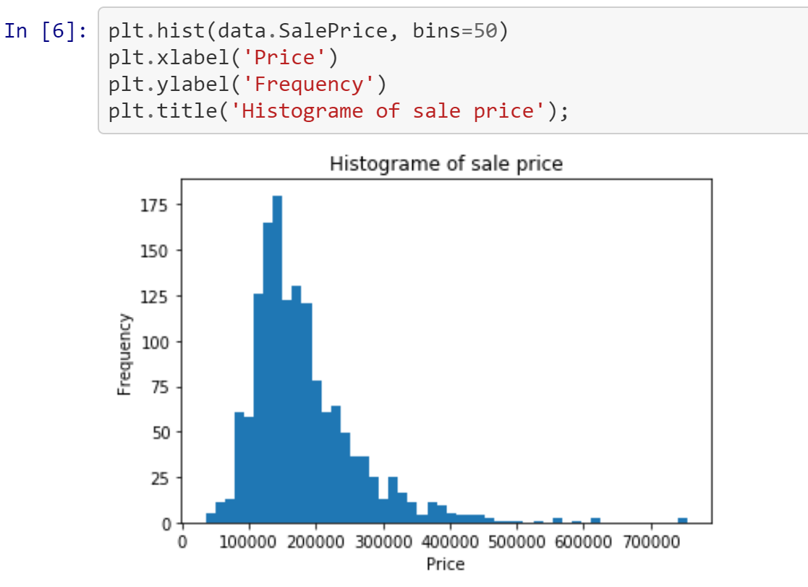
EDA

Slide 9
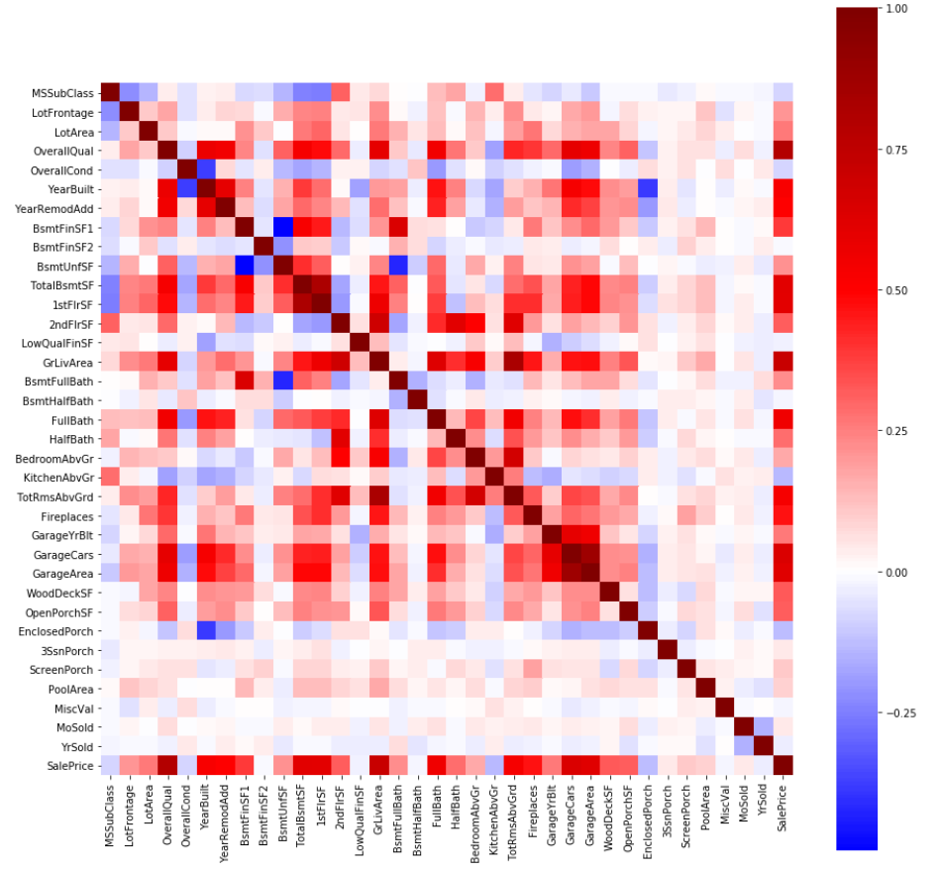
EDA

Slide 10
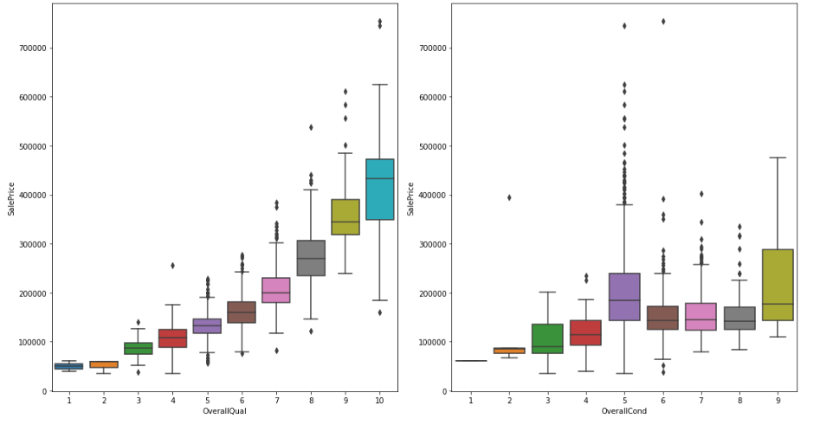
EDA

Slide 11
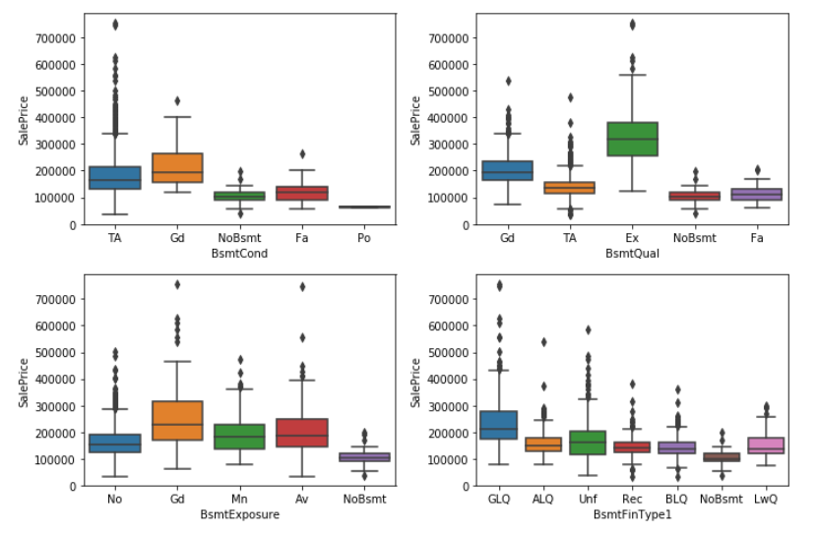
EDA

Slide 12
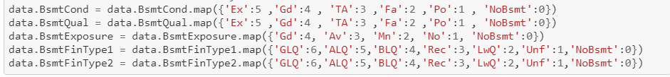
Label Encoder for Ordinal columns

Slide 13
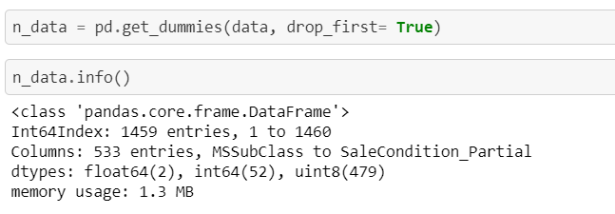
Convert nominal columns to One-hot encode

Slide 14
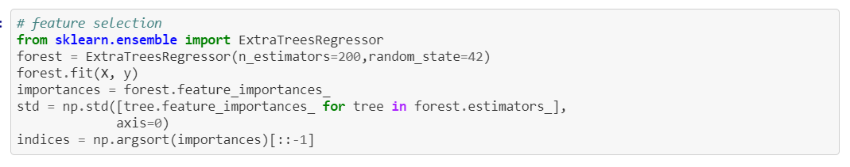
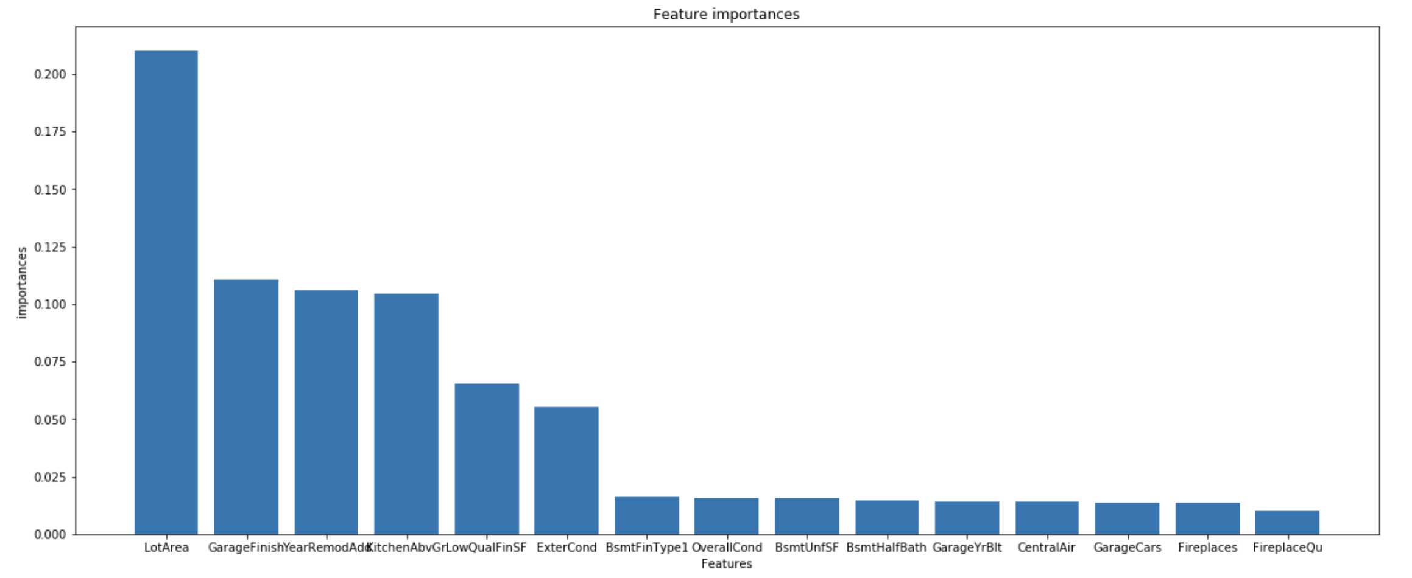
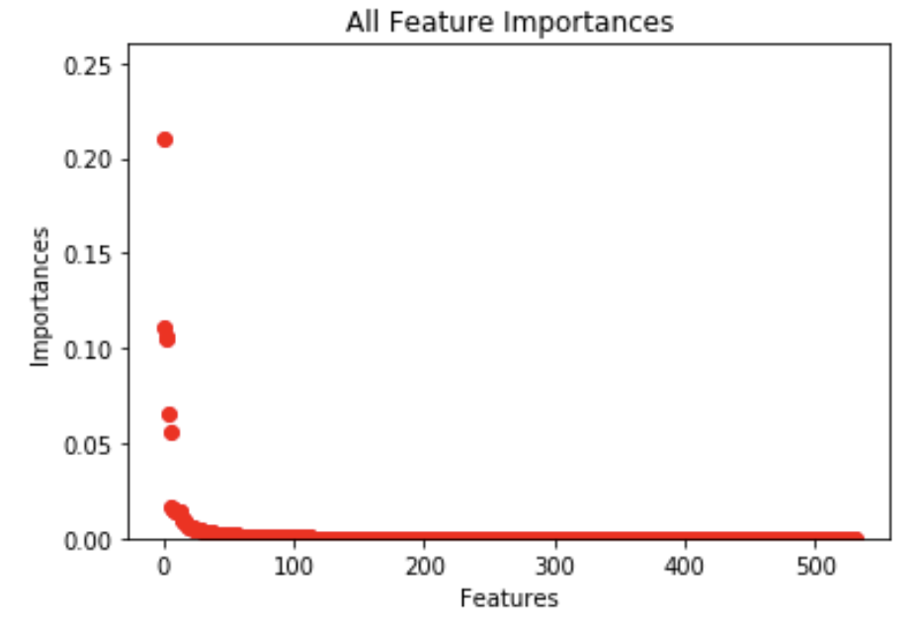
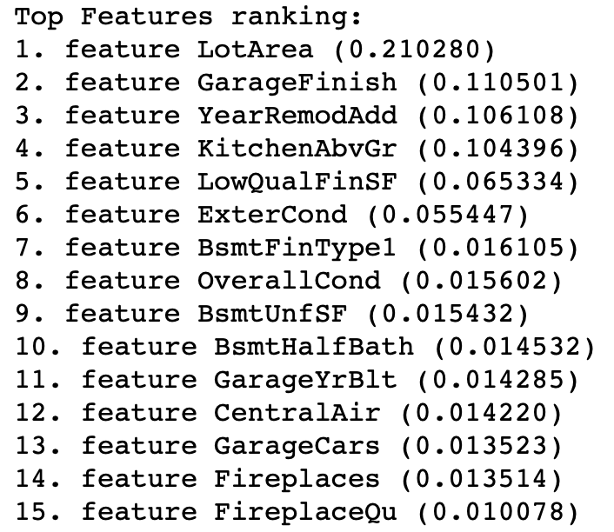
Feature Selection

Slide 15
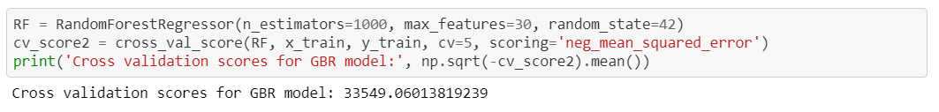
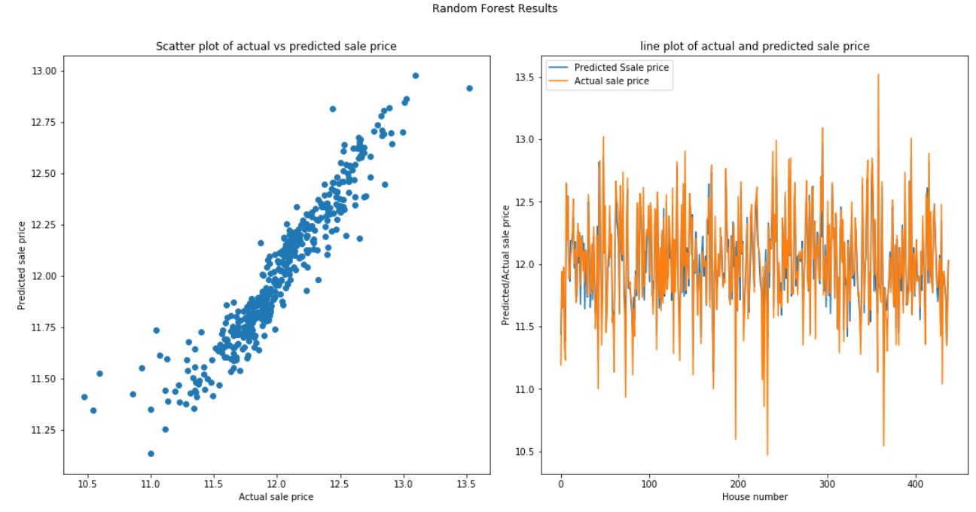
First attempt with Random Forest

Slide 16
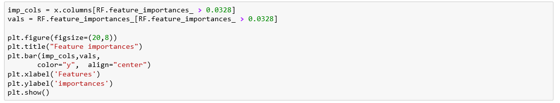
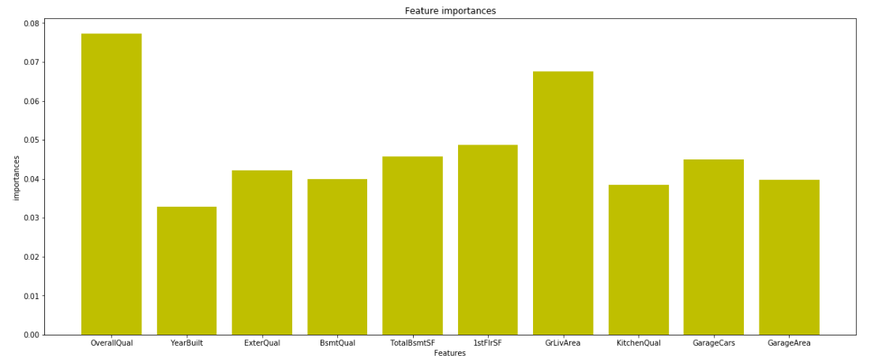
First attempt with Random Forest

Slide 17
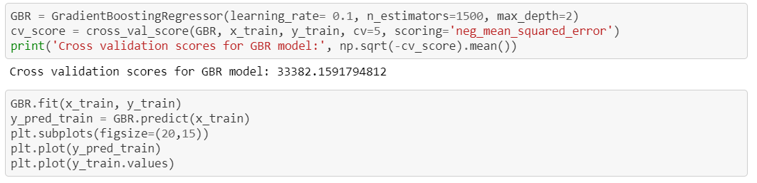
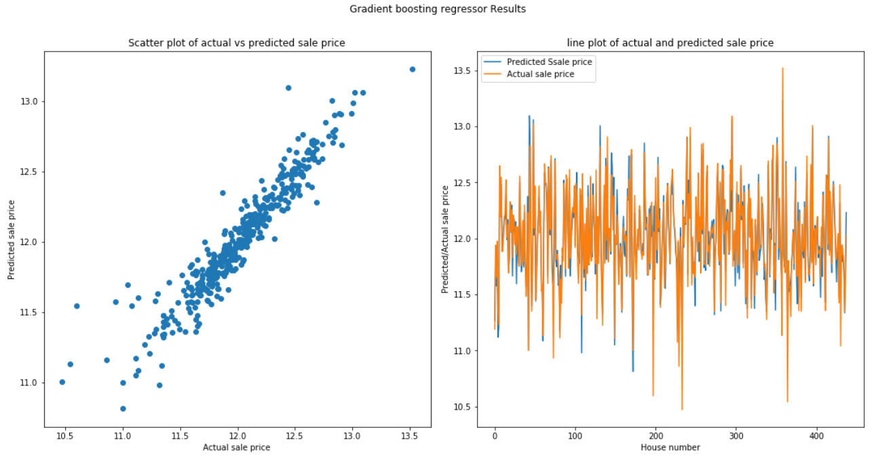
Second Attempt with Gradient Boost

Slide 18
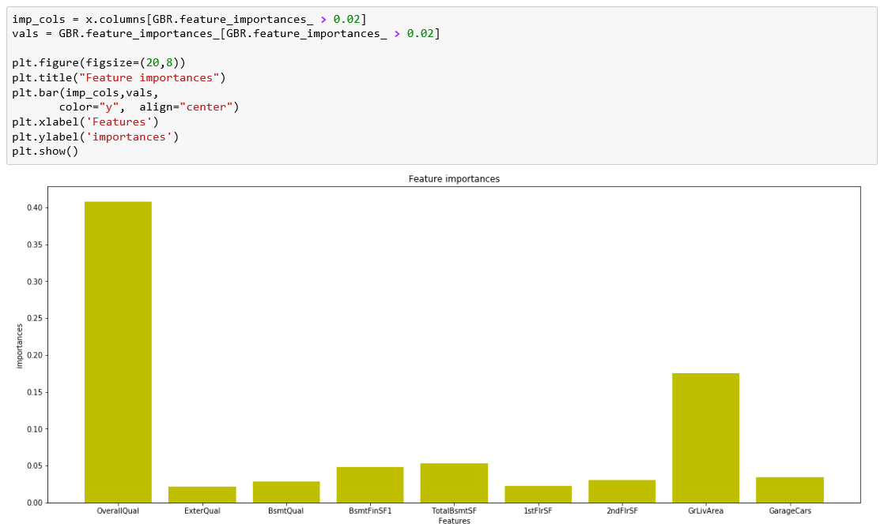
Second Attempt with Gradient Boost

Slide 19
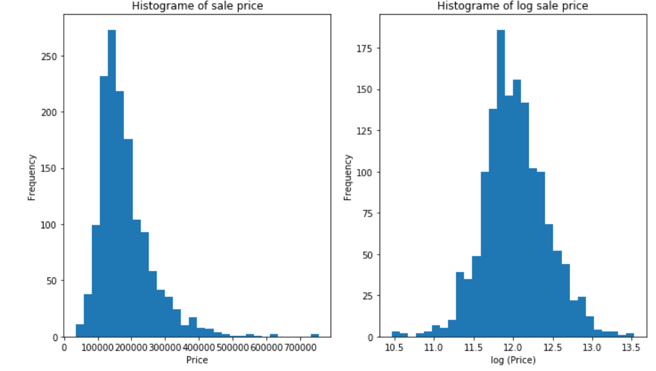
Sale Price Histogram

Slide 20
Our Plan
Algorithm
Org price
Log(Price)
Remove outliers

Slide 21
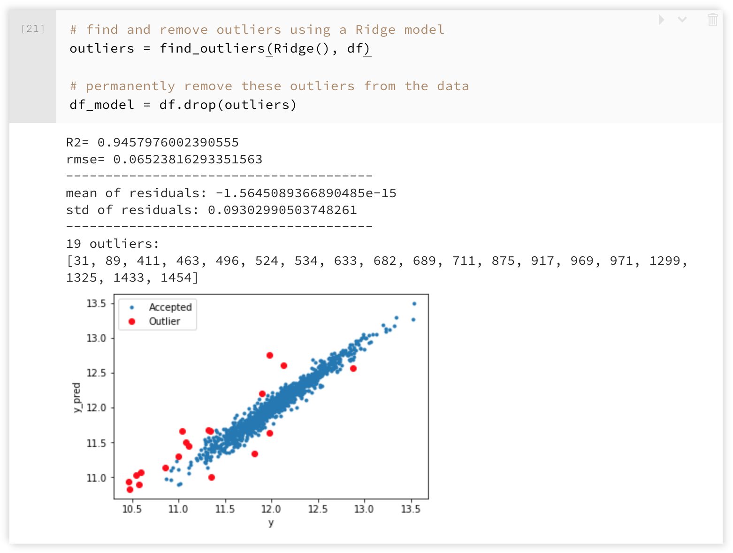
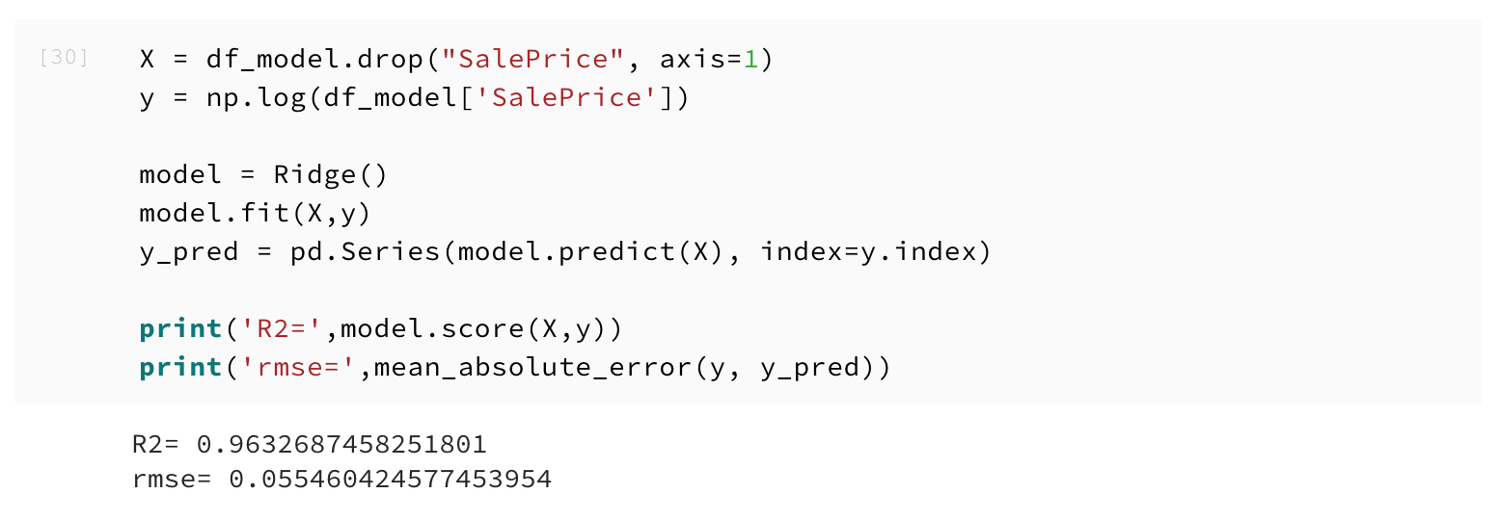
Identify and Remove Outliers

Slide 22
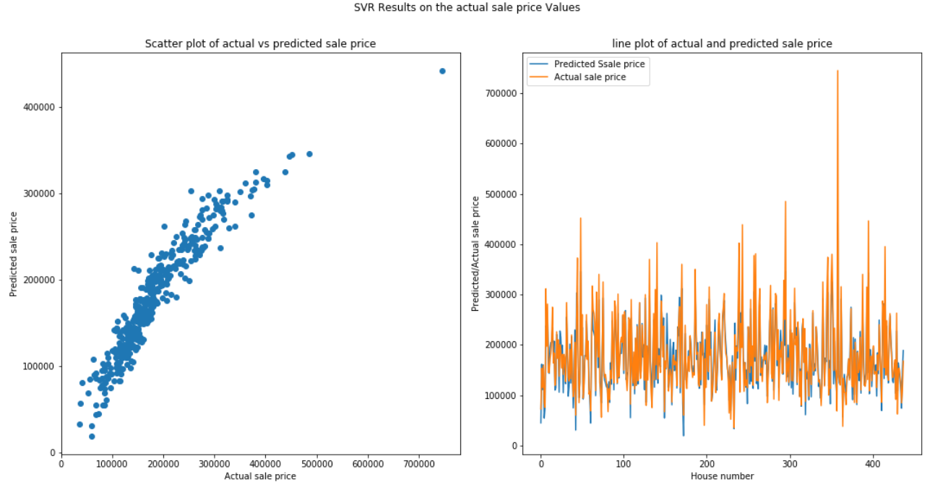
SVR Actual Price
Train on important Feature

Slide 23
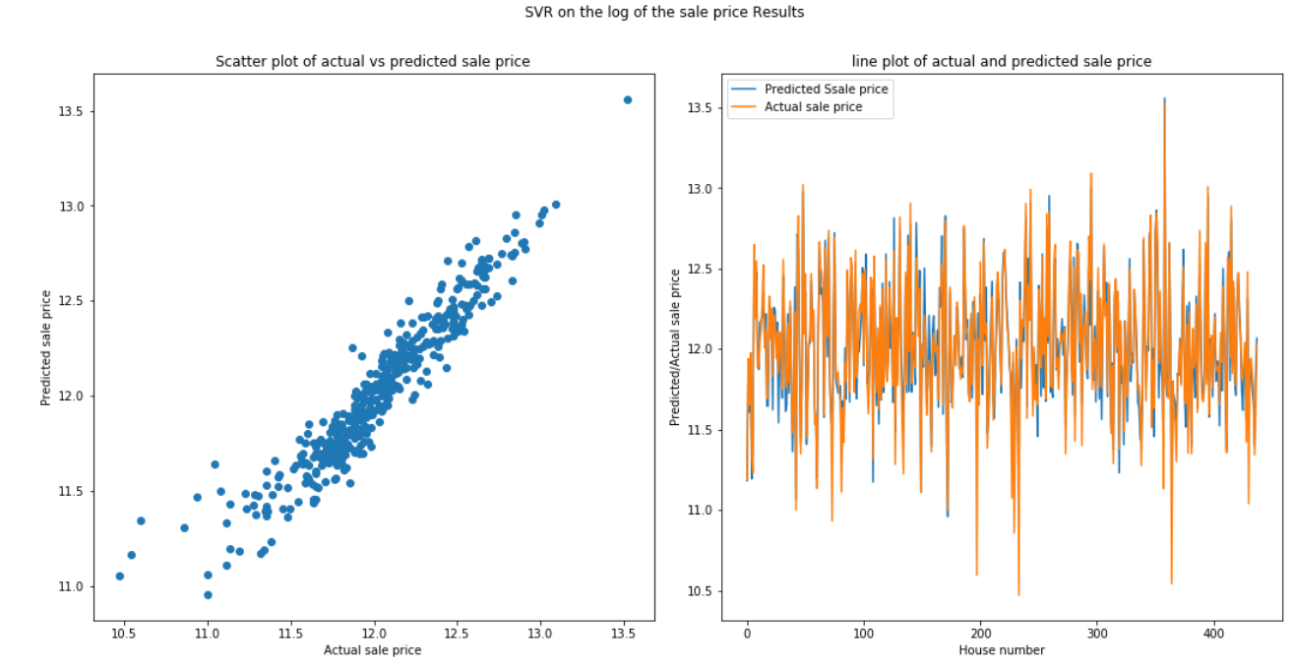
SVR Log (Price)
Train on important Feature

Slide 24
Conclusion
1: Model trained on actual data
2: Model trained on log(sale Price)
3: Model trained of data without outliers

Slide 25
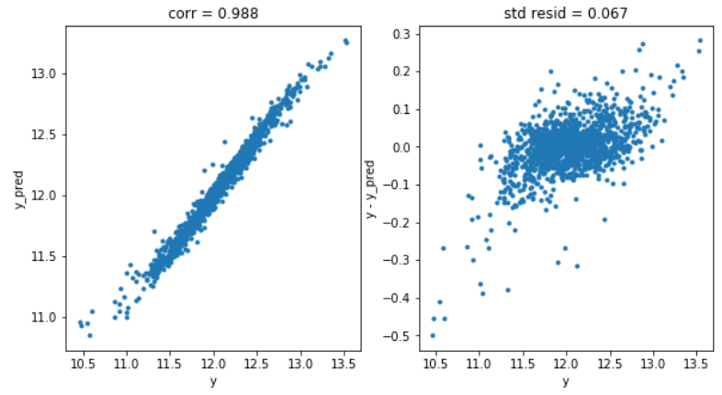
Random Forest Results

Slide 26

Thank You!

Slide 27
Fit Model
Linear Regression:
sklearn.linear_model.Ridge
sklearn.linear_model.Lasso
sklearn.linear_model.ElasticNet
Support Vector Machines:
sklearn.svm.LinearSVR
sklearn.svm.SVR
Nearest Neighbours:
sklearn.neighbors.KNearestNeighborsRegressor
Tree Based:
sklearn.ensemble.RandomForestRegressor
sklearn.ensemble.GradientBoostingRegressor
xgboost.XGBRegressor

Slide 28
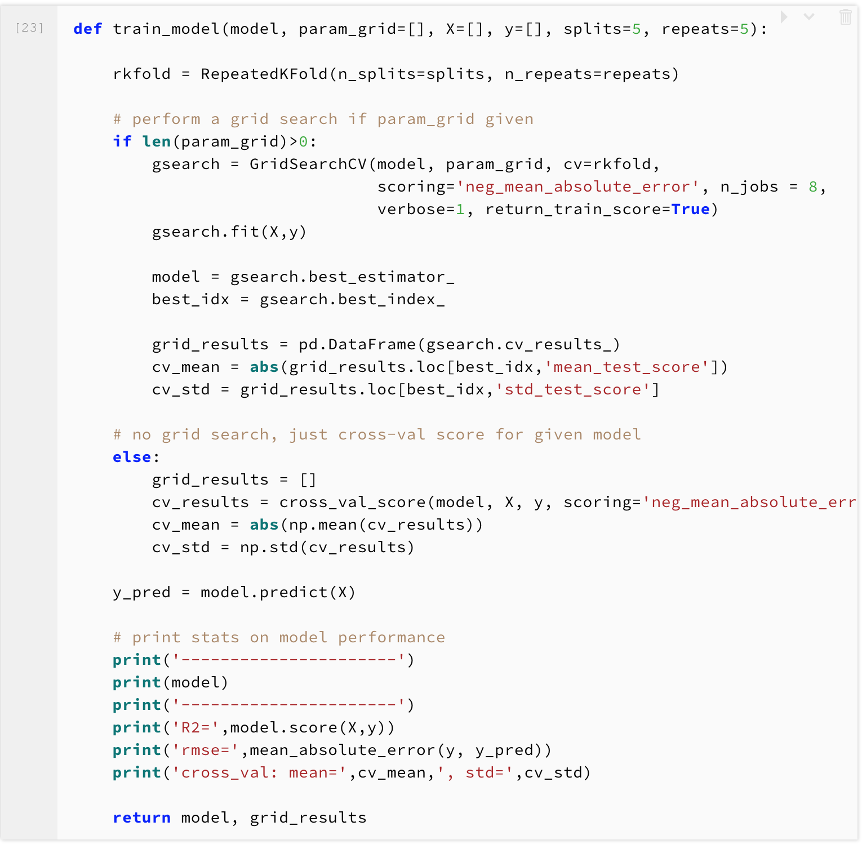
Train Model Function

Slide 29
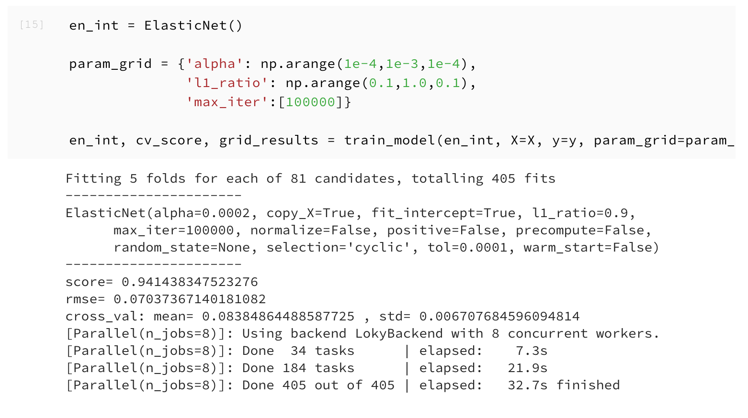
Elastic Net

Slide 30
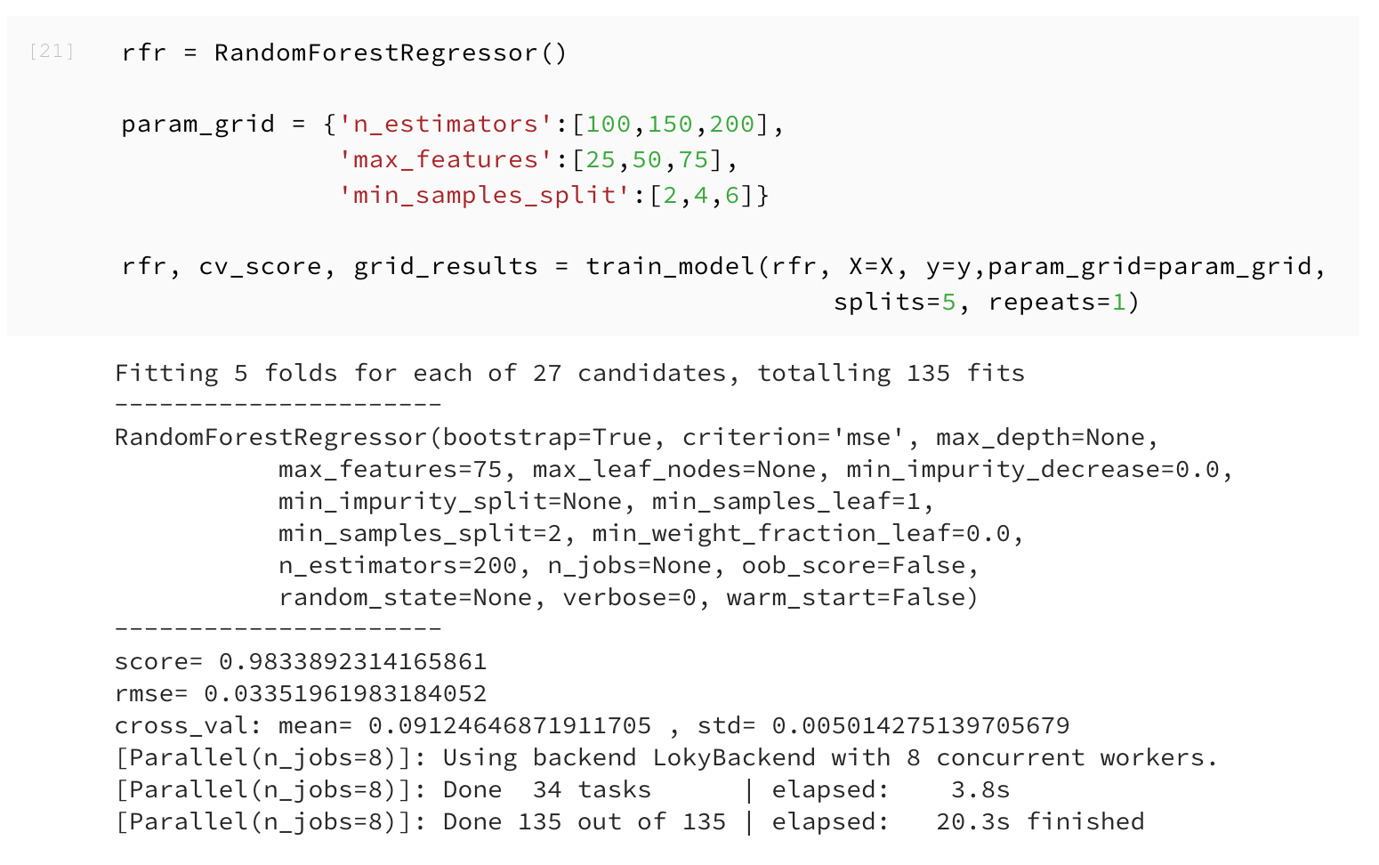
Random Forest

Slide 31
Compare Model with log(y)
 | R square (R2) | Root Mean Square Error (RMSE) | Mean | Standard Deviation (std)
Ridge | 0.9457976 | 0.0652382
Elastic Net | 0.9473058 | 0.07037367 | 0.08384865 | 0.00670768
Random Forest | 0.9877892 | 0.03351962 | 0.0912465 | 0.00501428

Slide 32
Compare Model without log(y)
 | R square (R2) | Root Mean Square Error (RMSE) | Mean | Standard Deviation (std)
Ridge | 0.95590900 | 11291.2240
Elastic Net | 0.91388614 | 15122.4778 | 16196.3887 | 829.09400
Random Forest | 0.98622979 | 5580.97214 | 15308.3902 | 999.77862

Slide 33
Compare Model with log(y)
We applied three algorithms in this part including Ridge, Elastic Net, Random Forest.
After removing outliers which identified by Ridge, the RMSE has slightly deceased.
Random Forest has better R2 and RMSE, but Elastic Net have better cross-validation scores.

Slide 34
The most important feature is LotArea, Lot size in square feet.

Slide 35
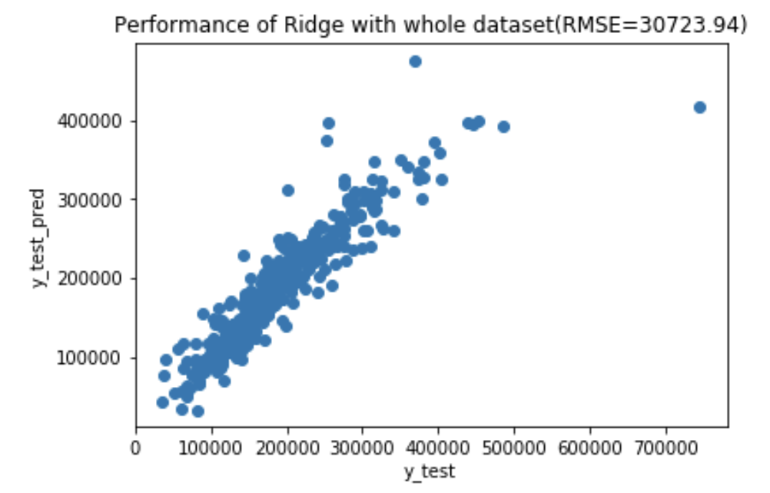
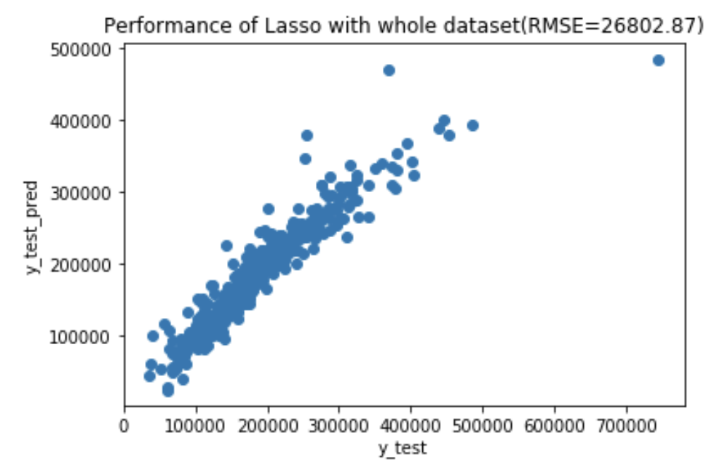
Fit into models

Slide 36
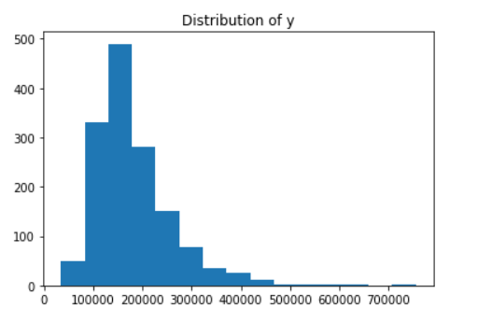
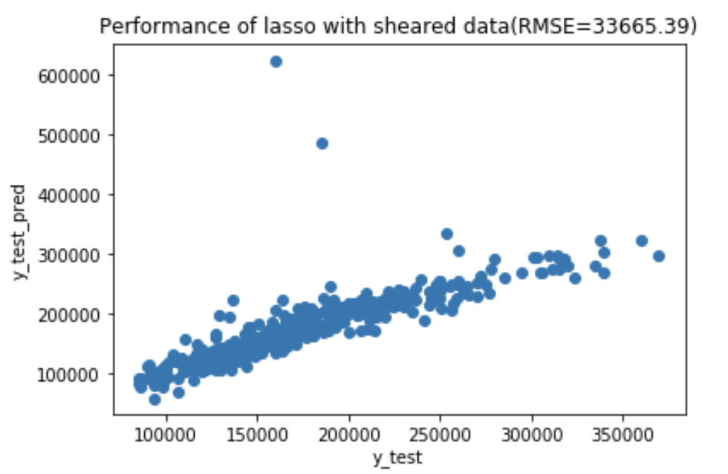
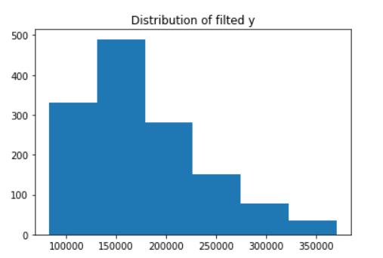
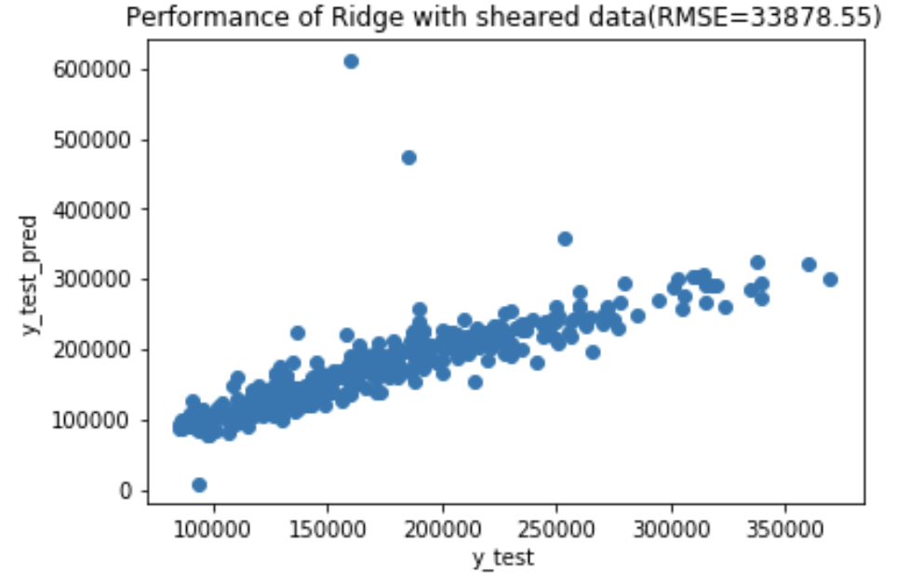
Remove outliers

Slide 37
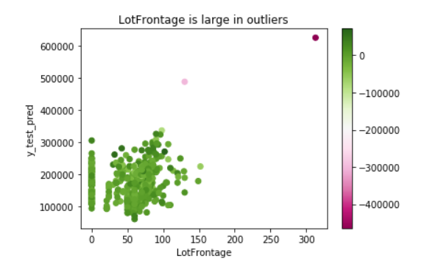
Remove outliers
LotFrontage: Linear feet of street connected to property

Slide 38
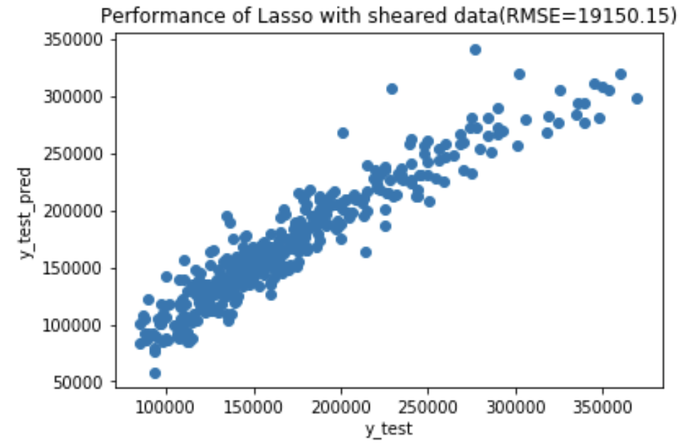
Remove outliers

Slide 39
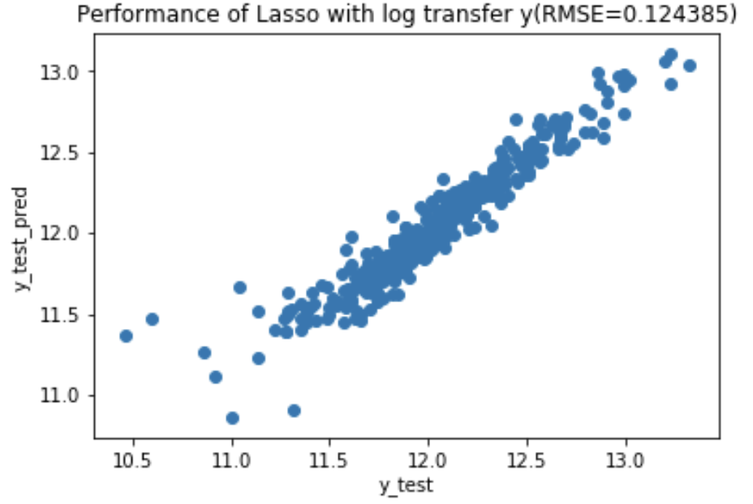
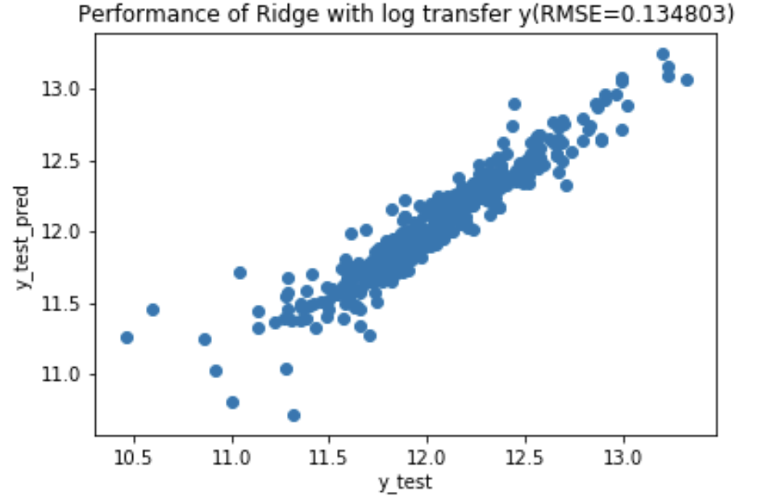
Log transform y

Slide 40
Conclusion
Conclusion
RMSE and R2:
ExtraTrees 27048.08 0.883939
Lasso 26802.87 0.803731
Ridge 30723.94 0.786243
Bagging Lasso 37058.150
Bagging Ridge 36500.47
Lasso with sheared data 19150.15 0.883223
Ridge with sheared data 21843.75 0.866617
Lasso with log transformed y 0.124385 0.902168
Ridge with log transformed y 0.134803. 0.897598

